Slide 1


COVID-19 Global Forecasting
Deep Learning
Guillem Amat, Sebastián Soriano Pérez
ECE 685, Fall 2020
November 13, 2020

Slide 2

Project Overview| Our project’s objective is to try different Deep Learning Models to predict COVID19 cases worldwide
Train Period
95 days
Test Period
45 days
US
Spain
Italy
China
Japan
23-January
26-April
10-June

Slide 3
Dataset| The data we used for the project came from the COVID19 Global Forecasting Competition at Kaggle
 | Variable Name | Description
Features | County | 3rd level of location. County for select Countries like the United States and Australia
 | Province | 2nd level of location. 1st order region of Countries like the United States.
 | Country | Country
 | Population | Country Population at the beginning of the pandemic
Time | Date | Date Index going from Jan-23 to Jun-10.
Target | Target | Confirmed Cases or Fatalities
 | TargetValue | Number of daily cases or fatalities reported
1M rows
140 days
187 countries

Slide 4




Data Preprocessing| The project had two different pipelines for the global and local datasets
Local Pipeline
Filter
Geocoding
Scale
Reshape
Sequences
Local
Dataset
5 countries
(5, 140, 5)
Train: (5, 69, 25, 5)
Test: (5, 19, 25, 5)
Original
Dataset
Data Wrangling
Global Pipeline
(969640, 9)
Reshape
Consolidate
Scale
Sequences
Global
Dataset
(3463, 140, 5)
(140, 5)
Train: (69, 25, 5)
Test: (19, 25, 5)

Slide 5
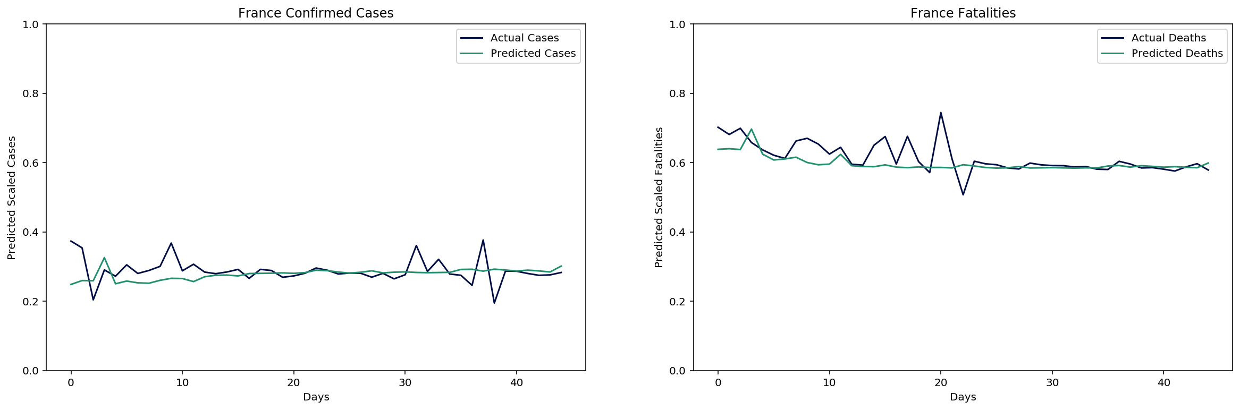
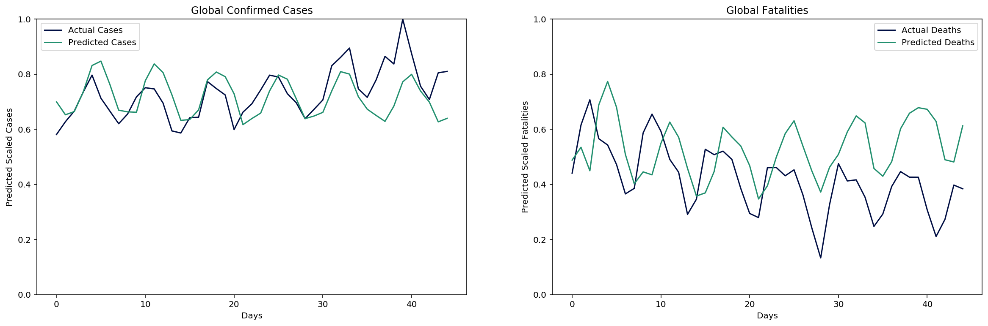
Artificial Neural Network| The plain-vanilla Neural Network picked up the trends at a Global level very well
Global Cases
Local Cases: France
Cases
Deaths

Slide 6
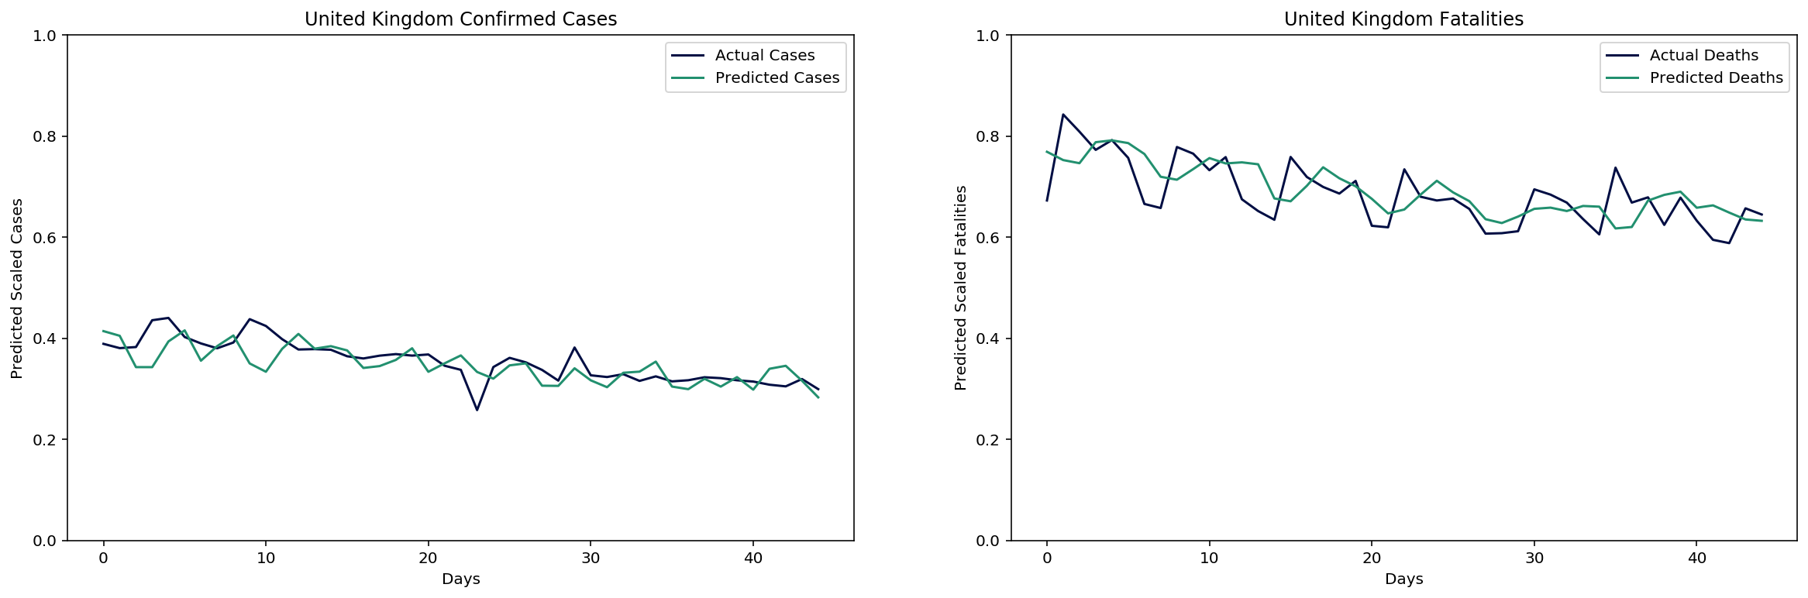
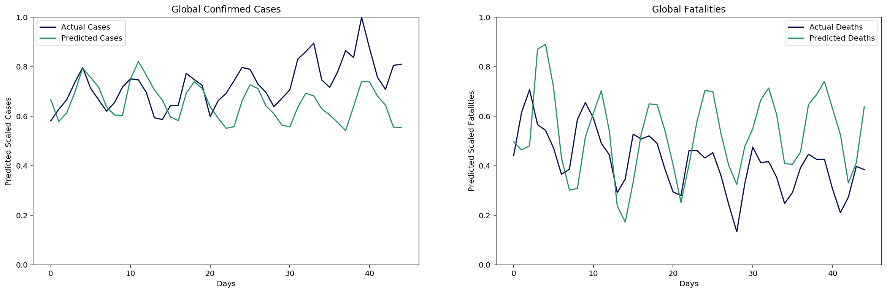
Convolutional Neural Network| The Convolutional Neural Network was quicker to train than the ANN offering similar results
Global Cases
Local Cases: UK
Cases
Deaths

Slide 7
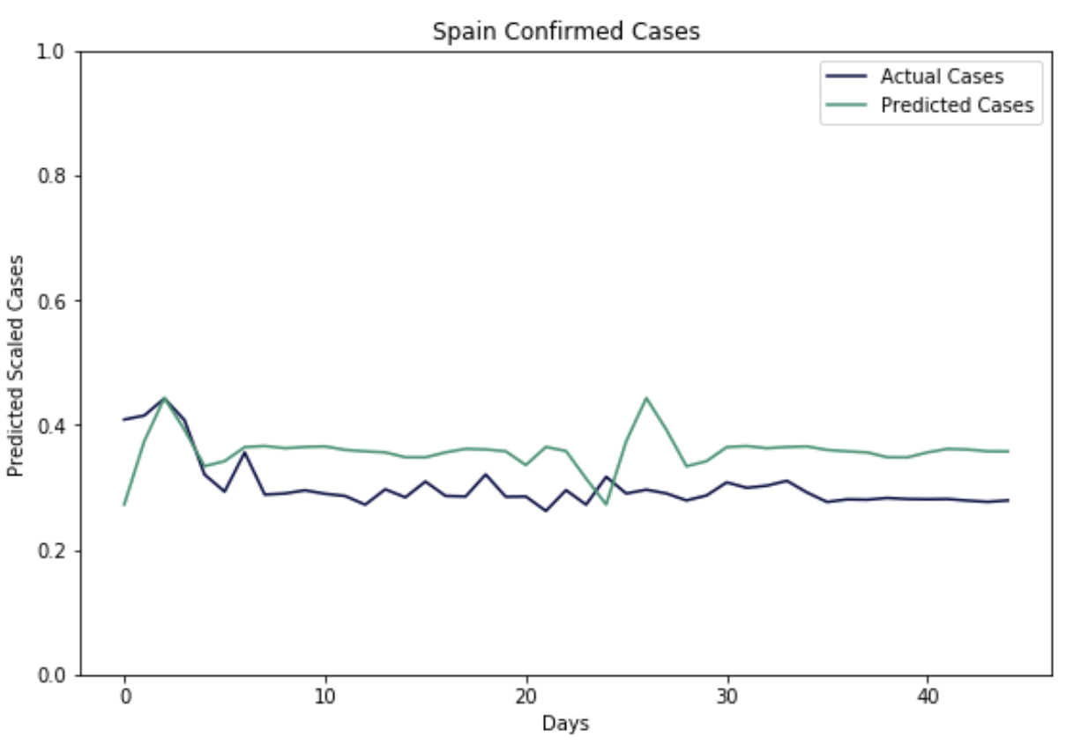
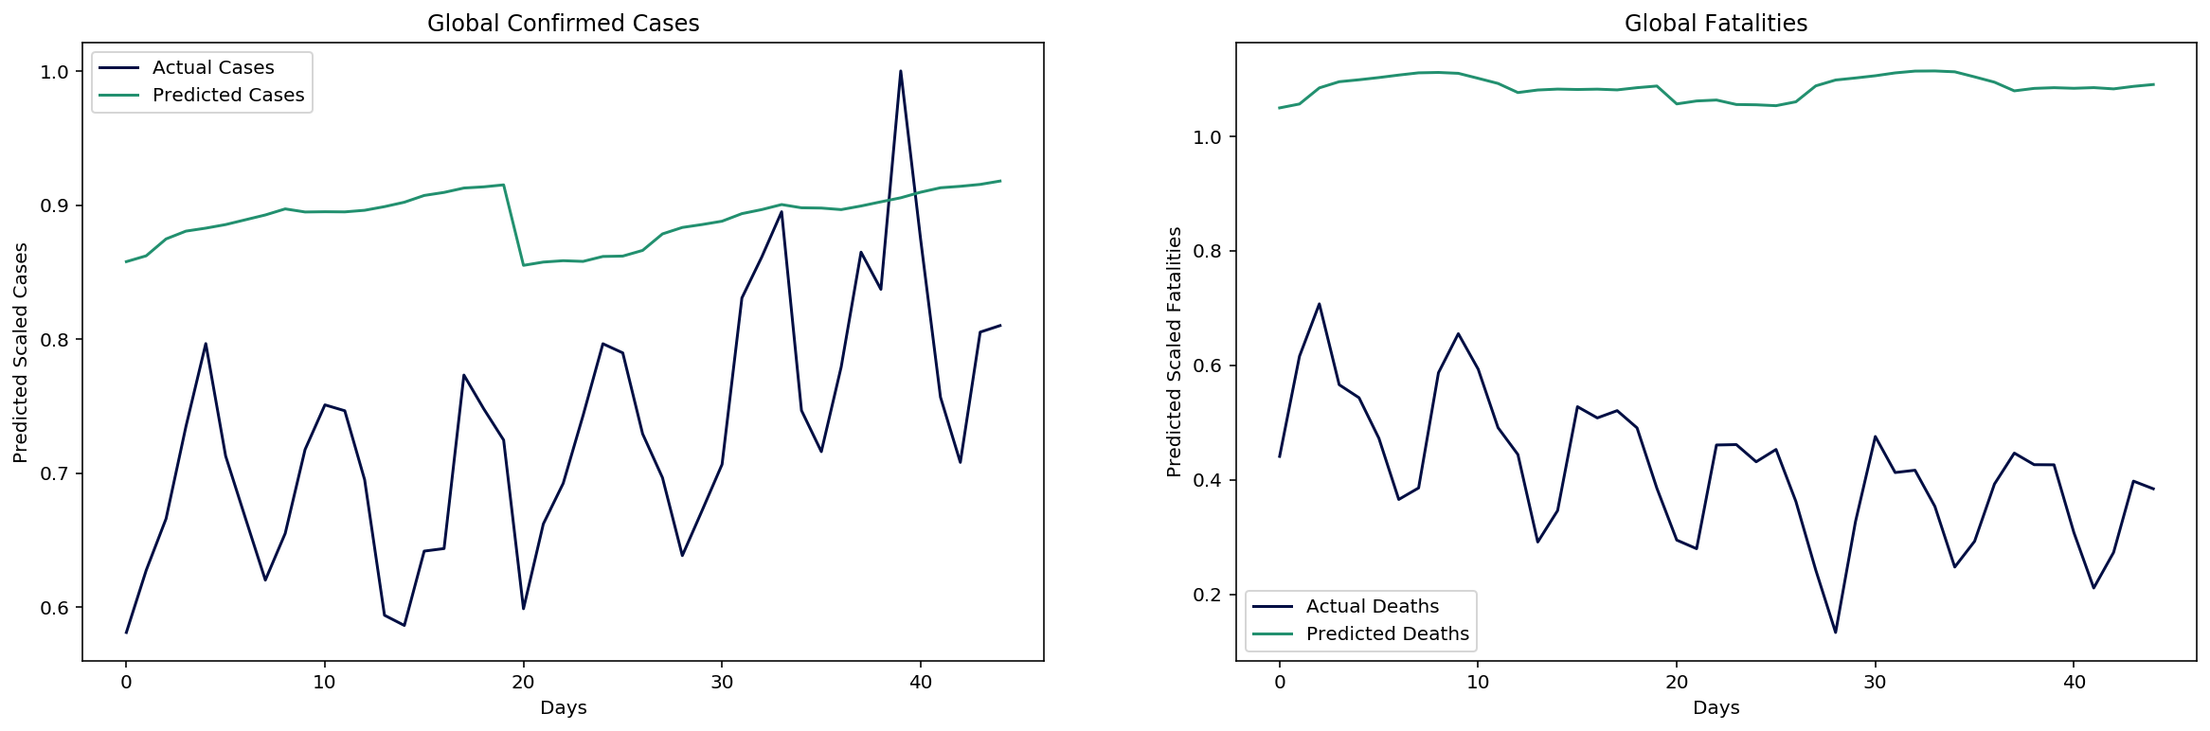
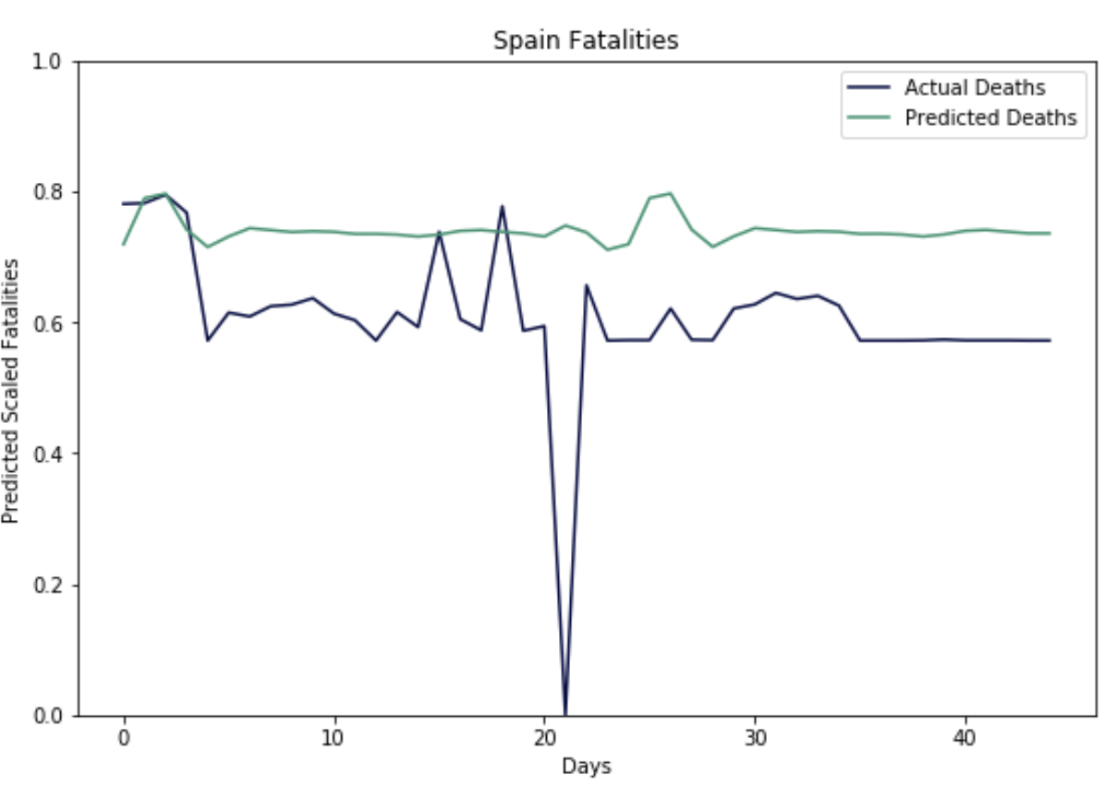
Gated Recurrent Unit| The Gated Recurrent Unit did a good job predicting cases at a local level but suffered at a global one
Global Cases
Local Cases: Spain
Cases
Deaths

Slide 8
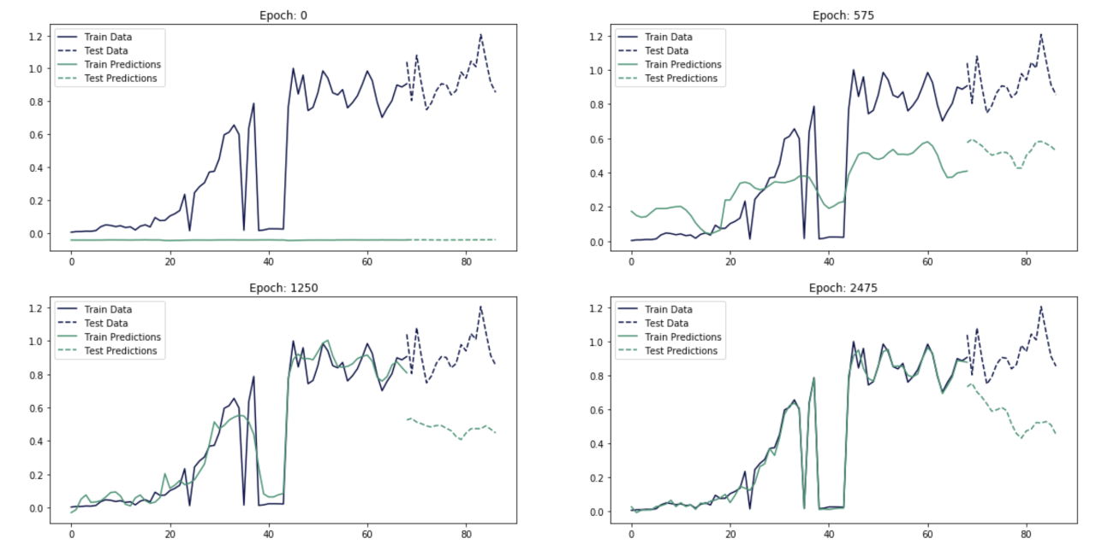
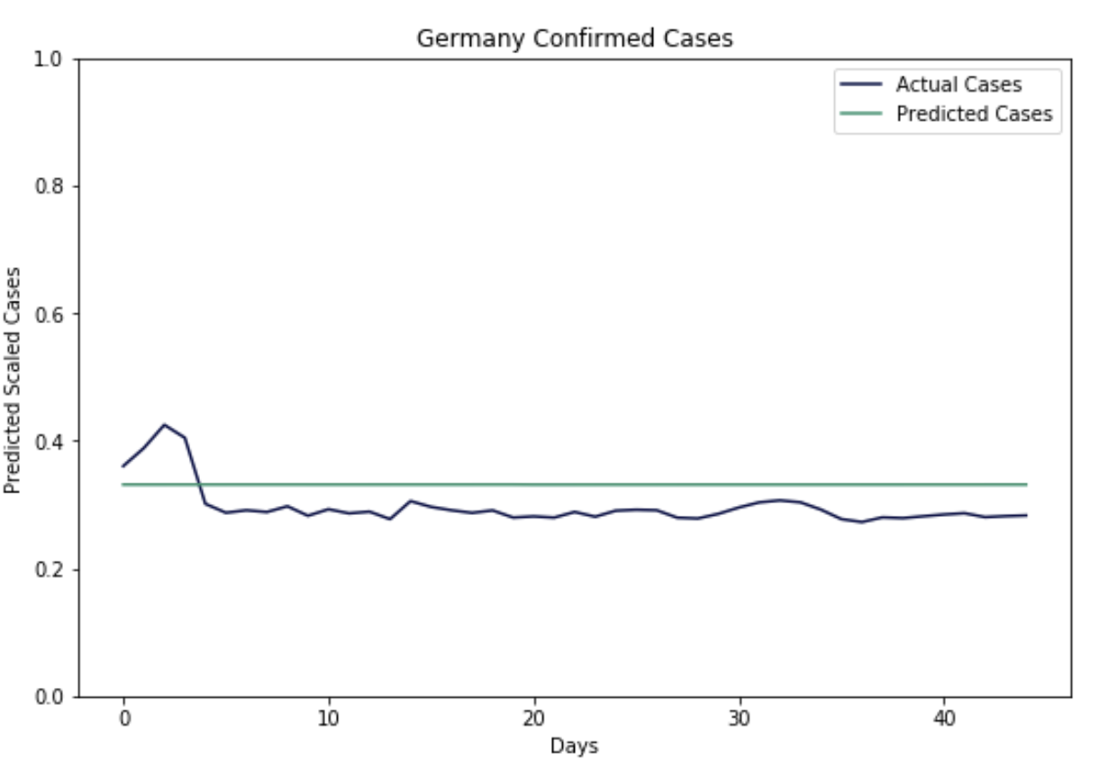
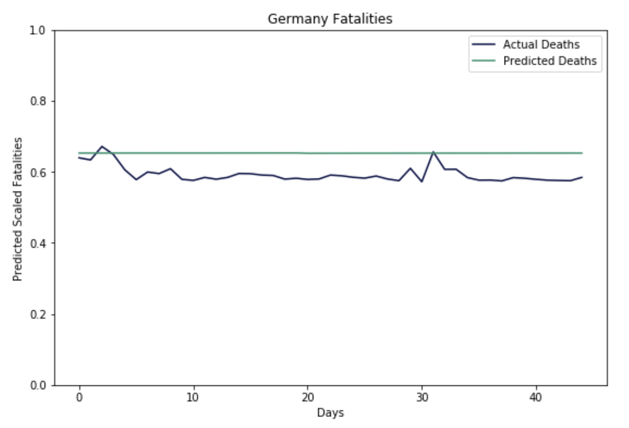
Long-Short Term Memory| The Long-Short Term memory can pick up trends globally but fails to do so locally
Global Cases
Local Cases: Germany
Cases
Deaths

Slide 9
Conclusions & Model Results| We can reasonably forecast future COVID19 cases at a Global scale, but models do not pick up trends locally
 | Global Loss | Local Loss | Hyperparameters | Comments
Artificial Neural Network | Train: 0.01 Test: 1.01 | Train: 0.20 Test: 0.13 | Learning Rate: 0.00025, Optimizer: Adam | Good results overall. Outperformed the recurrent NNs.
Convolutional Neural Network | Train: 0.11 Test: 1.29 | Train: 0.20 Test: 0.13 | Learning Rate: 0.00025, Optimizer: Adam | Similar performance to the ANN, obtained same results on last epoch for local models.
Gated Recurrent Unit | Train: 11.56 Test: 4.51 | Train: 0.98 Test: 0.07 | Weight Decay: 0, Dropout: 0.01, Learning Rate: 0.00025, Optimizer: Adam | Very similar results to LSTM globally but better results locally.
Long-Short Term Memory | Train: 0.22 Test: 6.45 | Train: 0.96 Test: 0.13 | Weight Decay: 0, Dropout: 0.01, Learning Rate: 0.00025, Optimizer: Adam | Picks up trends globally around 575. It starts overfitting at 1250. Does not pick up trends locally.

Slide 10
Next Steps| The results we have obtained are reasonable at a global level, but we would like to continue our work at the local level
Extra Data
Extra Models
Data Source | Description
New York Times data | Data on interesting indicators of US states and counties like Mask Use
European Center for Disease Prevention and Control | Extended dataset of all countries in the world updated to the present date
Center for Disease Control | Data on US states and counties for tests administered and ventilator availability
Model | Description
Time-Aware LSTM | T-LSTM is a particular implementation of LSTM designed to handle irregular elapsed times. It is able to capture temporal dynamics well.
Encoder-Decoder GRU | An enhanced version of the GRU that gives better results in seq2seq and Natural Language Processing tasks.
GRU-ODE-BAYES | A Bayesian version of GRUs fitted by using Ordinary Differential Equations. It allows for the introduction of a

